Slide 1



Online Data Drift Detection for
Anomaly Detection Services based on
Deep Learning towards Multivariate Time Series
Gou Tan, Pengfei Chen*, Min Li
Notes:
Good afternoon everyone,
Today, I'd like to share with you my work “Online Data Drift Detection for Anomaly Detection Services based on Deep Learning towards Multivariate Time Series”.

Slide 2
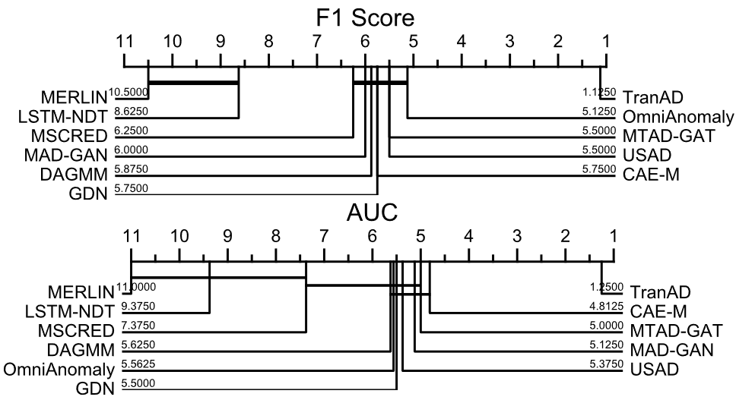
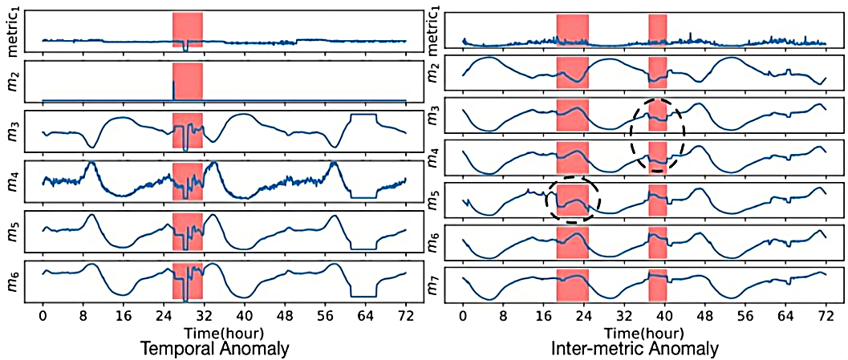
Background
Deep learning models have been applied in anomaly detection for multivariate time series.
Two types of anomalies [1]
Critical difference diagrams [2]
[1] Z. Li et al,. Multivariate time series anomaly detection and interpretation using hierarchical inter-metric and temporal embedding. SIGKDD, 2021.
[2] Tuli S et al,. Tranad: Deep transformer networks for anomaly detection in multivariate time series data. 2022.
Notes:
In recent years, deep learning has made progress in anomaly detection for multivariate time series. They are widely used in finance, healthcare, and industrial monitoring. They can extract time dependency and hidden patterns from the data. On the left, the red regions are two types of anomalies: temporal and inter-metric. As we can see, temporal anomaly violates the time patterns, and inter-metric anomaly violates history relations. On the right, it is a comparison of different methods based on F one score and AUC.

Slide 3
Background
Is deploying the high-performing models as a service the last step?
Data
preparation
Feature
engineering
Model
training
Model
evaluation
Model
deployment
Monitoring
?
Notes:
As shown here, the machine learning lifecycle includes “data preparation”, “feature engineering”, “model training”, “model evaluation”, “model deployment”. However, Is deploying models the last step? In the machine learning operations, we face the challenge that both the training data and the model may be outdate. It can lead to a performance degradation of inference. As a result, monitoring becomes crucial to achieve a closed-loop lifecycle.

Slide 4
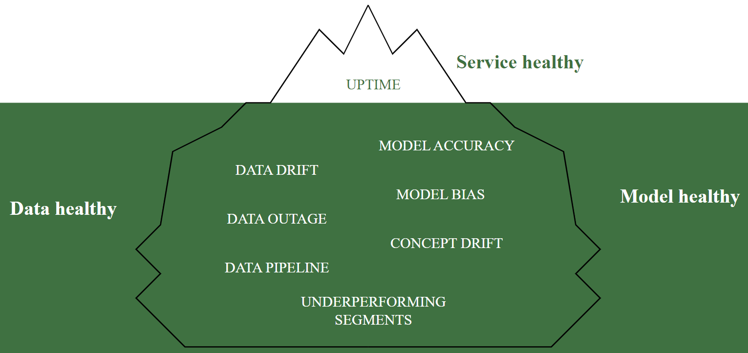
Background
What do we need to monitor? & Can we monitor them?
Notes:
So, what do we need to monitor? We focus on the machine learning service healthy. It can be divided into data healthy and model healthy. Here are some metrics to consider, including data drift, model accuracy and so on. But in reality, there are some limits.

Slide 5
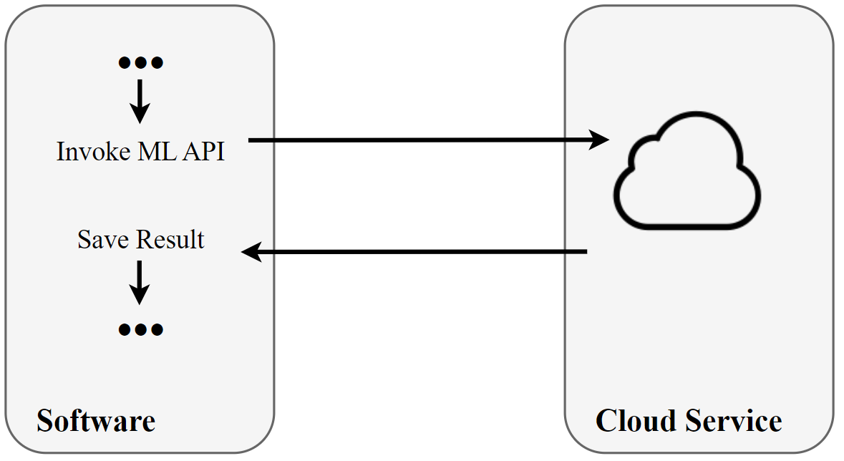
Background
What do we need to monitor? & Can we monitor them?
Notes:
For example, we often use pre-trained machine learning APIs to accomplish tasks without training by ourselves. It seems be a black-box. We don’t know the model structure, model parameters, and source code.

Slide 6
Background
Challenges
The Quality of Model Services Lacks Standards.
Lack of Data Drift Labels.
The Detection Method Needs to be Updated in Time.
Interpretability.
Notes:
Therefore, we propose the following challenges for monitoring services:
For the first challenge, While latency and overhead are commonly used to evaluate system quality, there is a lack of standards for evaluating the quality of model services.
Secondly, it is difficult to get ground truth when the service is online. We need to apply unsupervised methods.
Thirdly, Traditional drift detection methods rely on history data, so it's crucial to update the detection method in time.
Lastly, We need design methods to provide interpretations.

Slide 7
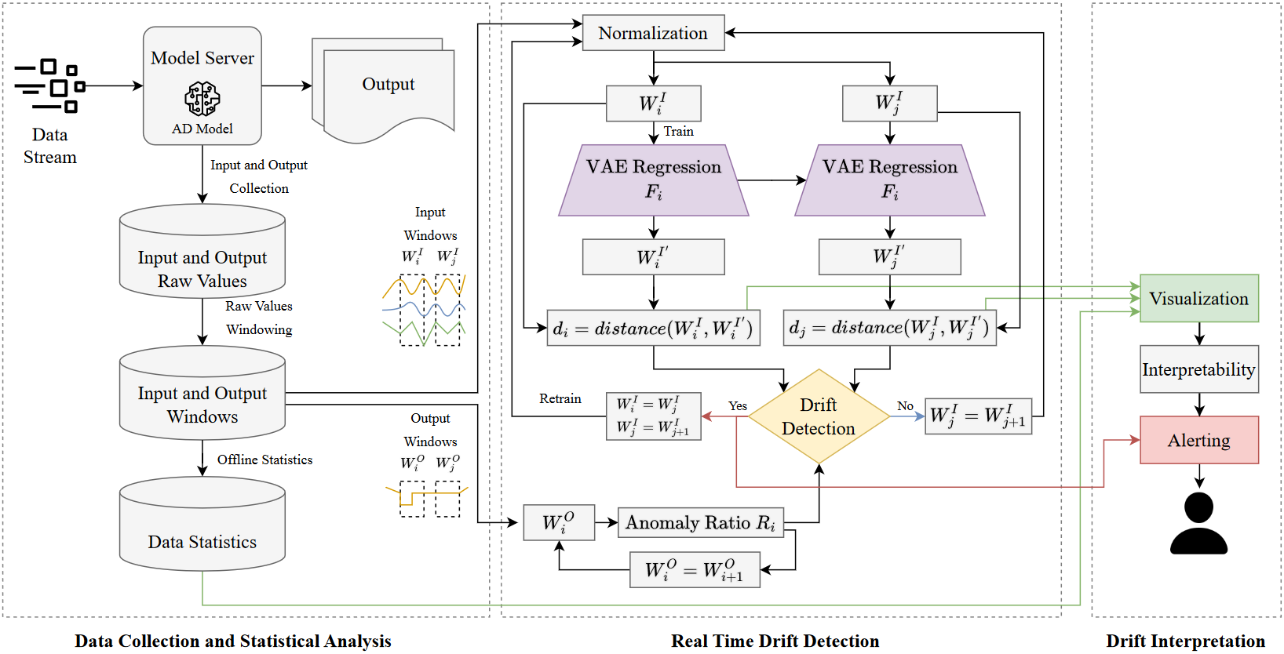
Overview design
End-to-end Monitoring Approach
Notes:
To address these challenges, we have designed an End-to-end Monitoring Approach. It consists of three parts.

Slide 8
Overview design
Data Collection and Statistical Analysis
Collect data without invasion
Notes:
First, we collect data and get statistical analysis. We modify the source code of the model server so that it can collect the input and output data without invasion. The collected data is windowed online and Statistically analyzed offline.

Slide 9
Overview design
Real Time Drift Detection
Apply deep learning drift detection algorithm
Notes:
Second, we achieve real-time drift detection. For the input data, we use the deep learning to fit history data and share it with the current data to get differences over time. For the output data, we compute the ratio of anomaly detection model predictions. By combining these changes, we can determine if data drift has occurred and then update the system.

Slide 10
Overview design
Drift Interpretation
Interpret drift through multiple data sources
Notes:
Finally, we can interpret the drift reasons by visual analysis of original values, statistical values, and drift detection metrics.

Slide 11
Experiment
Research Questions
RQ1. The Effectiveness of Drift Detection
RQ2. The Effectiveness of Monitoring Anomaly Detection Models
RQ3. The Interpretability of the Model Performance
Notes:
In our experiments, we focused on three main questions.

Slide 12
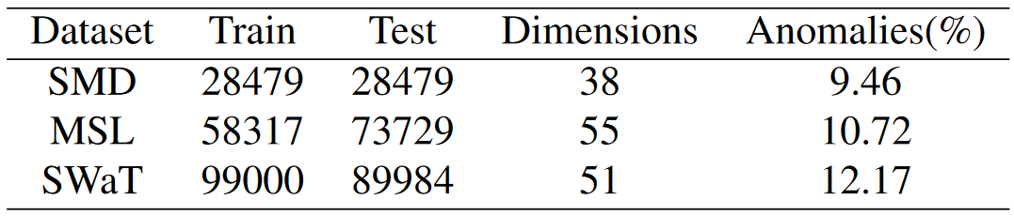
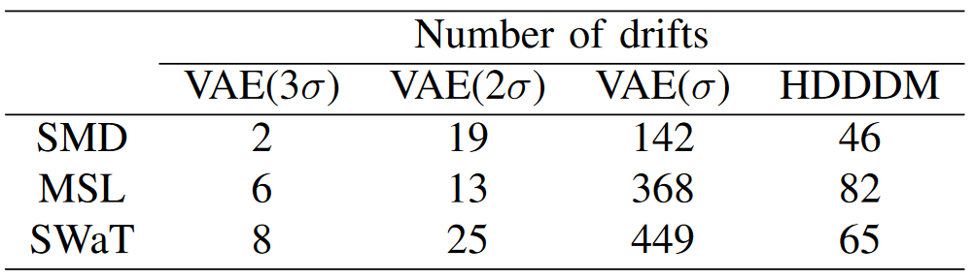
Experiment
RQ1. The Effectiveness of Drift Detection
Notes:
Firstly, we evaluated the effectiveness of drift detection. We tested our method on three public datasets. All of them are multivariate time series. The results indicate that all three datasets have data drift.

Slide 13
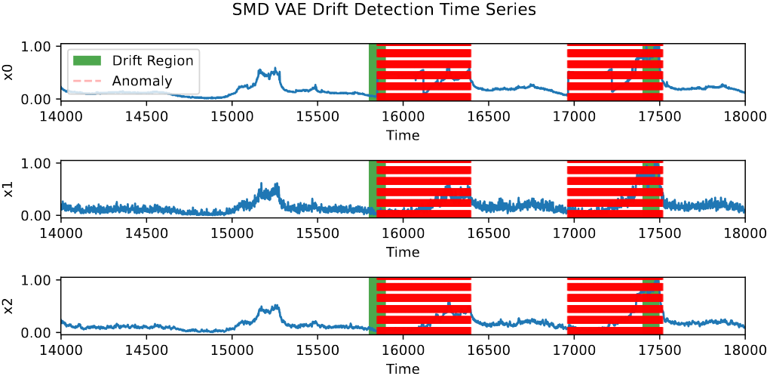
Experiment
RQ1. The Effectiveness of Drift Detection
Notes:
We visualized the results and highlighting the drifts in green.

Slide 14
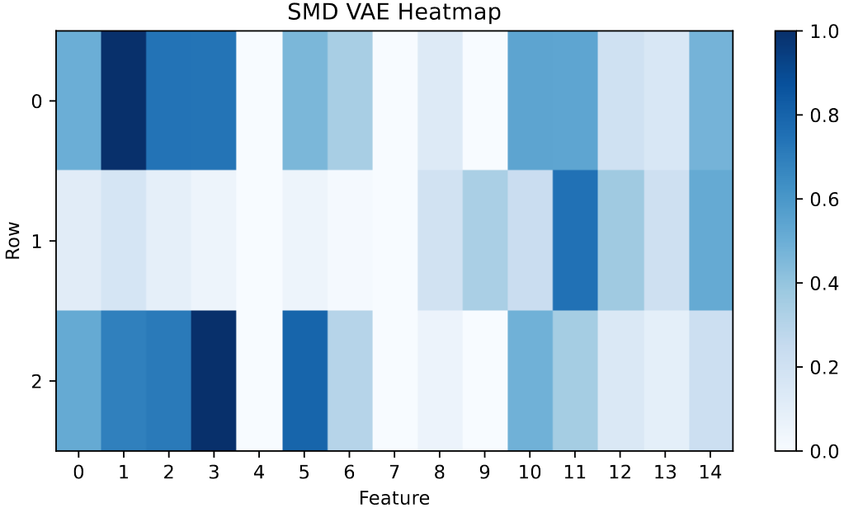
Experiment
RQ1. The Effectiveness of Drift Detection
Notes:
Additionally, we used heatmaps to analyze which features caused the drifts. The deeper the color, the greater the impact.

Slide 15
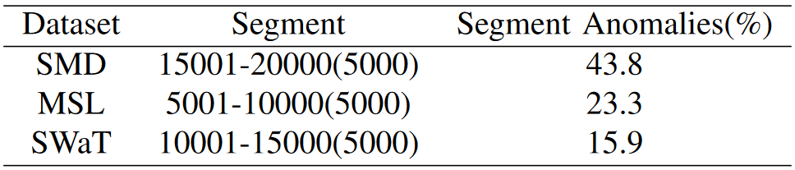
Experiment
RQ2. The Effectiveness of Monitoring Anomaly Detection Models
Notes:
Secondly, whether monitoring is effective. We compared the performance of different anomaly detection methods on the three datasets.

Slide 16
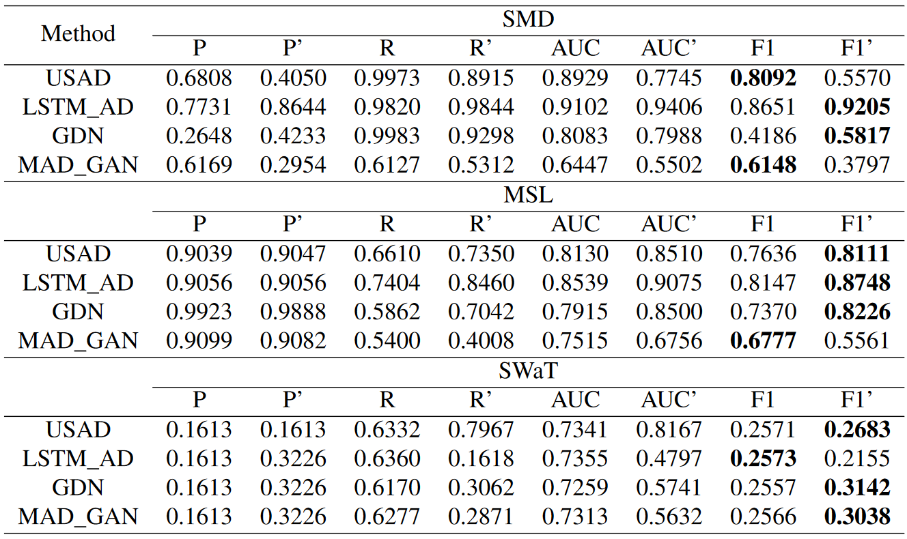
Experiment
RQ2. The Effectiveness of Monitoring Anomaly Detection Models
Notes:
As a result, The monitoring improved the F-one score with a maximum improvement of zero-point-eighteen. We selected the experiment with the best performance to analyze the interpretability of the model.

Slide 17
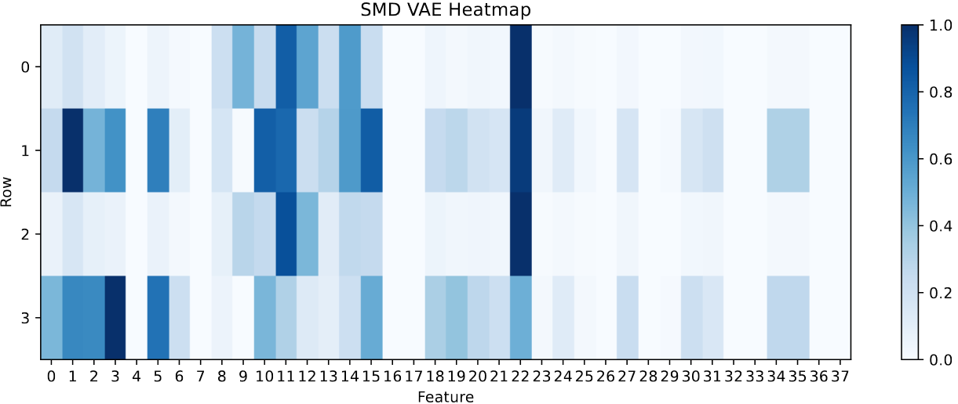
Experiment
RQ3. The Interpretability of the Model Performance
Notes:
So for the question 3, Through the heatmap, we can observe that feature twenty-two has the most significant impact in multiple drifts.

Slide 18
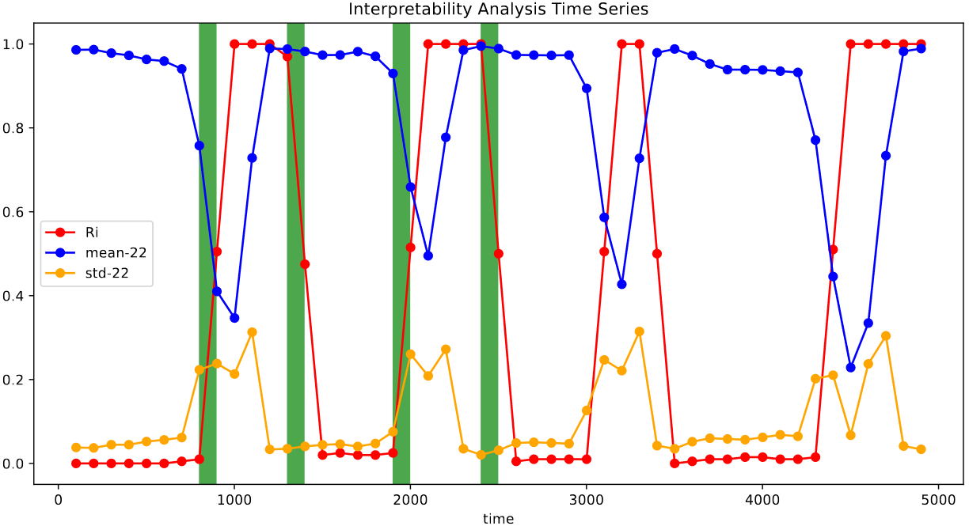
Experiment
RQ3. The Interpretability of the Model Performance
Notes:
Then, we visualize the mean and standard deviation of feature twenty-two. So we can get a conclusion that the proportion of anomaly detection predictions is related with the change of feature 22. It indicates that our method has interpretability.

Slide 19
Summary
Key Contributions
A novel data-driven monitoring scheme for MTS anomaly detection services.
One of the earliest attempts to apply deep learning-based drift detection algorithms to MLOps monitoring.
A method that accurately detects data drift in services based on deep learning and provides reasonable interpretations.
Notes:
In conclusion, our research has made three main contributions:
We have developed a novel data-driven monitoring scheme for anomaly detection services in multivariate time series.
Our approach is one of the earliest attempts to apply deep learning drift detection algorithms to monitoring. It achieves high-performance analysis through unsupervised deep learning.
We've successfully designed a method that accurately detects data drifts in services based on deep learning principles and provides reasonable interpretations.

Slide 20
Thank You For Listening!
Q & A
Gou Tan: tang29@mail2.sysu.edu.cn
Pengfei Chen: chenpf7@mail.sysu.edu.cn
Notes:
Thank you for your attention. I'm happy to answer any questions you may have.

